Slide 1

SB 375 in the
San Joaquin Valley
September 17, 2014
Katelyn Roedner • Catholic Charities Stockton Diocese
Veronica Garibay • Leadership Counsel for Justice & Accountability
Ella Wise • Natural Resources Defense Council

Slide 2
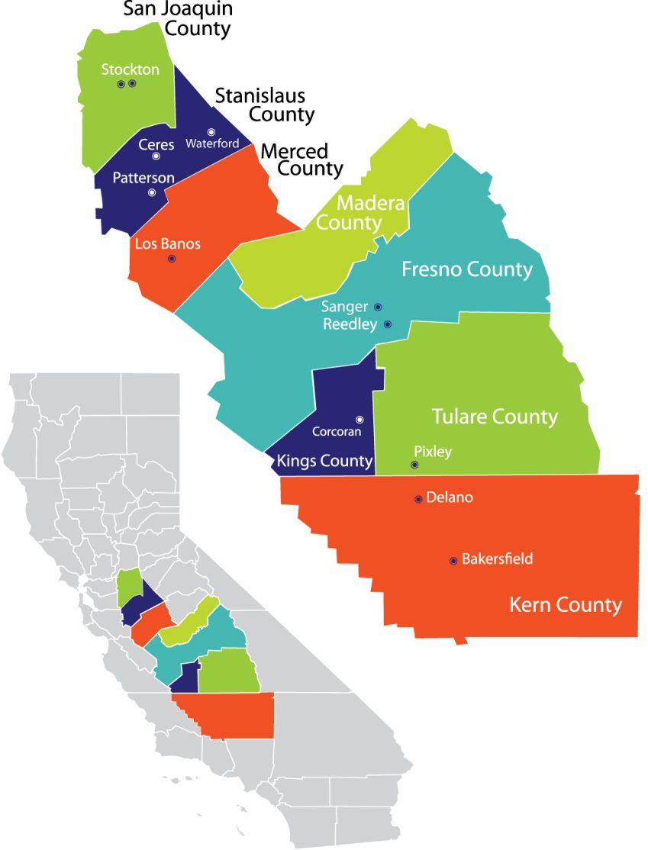
Welcome to San Joaquin Valley!
POP QUIZ: San Joaquin
Valley is made up of
how many MPO’s?
ANSWER: 8
There are 8 separate regions in San Joaquin Valley, 8 separate COGs,
and 8 separate SCSes.
GHG reduction targets for each are 5% by 2020 and 10% by 2035.
Notes:
In my previous job, I was a high school algebra teacher, so I’d like to start off with a pop quiz! I never subjected my students to this, but you guys aren’t so lucky.
Each region has to meet these targets individually – Valley leaders were opposed to these targets.

Slide 3
But it’s not all fun and games…
 | San Joaquin | Fresno | Kern
Air quality (short term particle pollution – SOTA 2014) | 10th in United States (SJ-SF-Oakland-Stockton) | 1st in the United States | 3rd in the United States (Bakersfield)
Poverty (below poverty line - US Census Bureau, 2012) | 17.5 % | 24.8 % | 22.5 %
Growth (by 2035, per CA Dept of Finance) | 62 % | 42 % | 75 %
Notes:
These are the three regions we are highlighting today – so a quick picture of the challenges the Valley faces.
Air quality is very poor, poverty is high, and growth is happening fast.
For reference, the overall CA poverty rate is about 15%
Entire Valley is expected to double in size by 2060 – lead by San Joaquin and Kern as suburbs or exurbs of Bay Area, Sacramento, Los Angeles. State as a whole expected to grow 39% by 2060.

Slide 4

San Joaquin and Stanislaus

Slide 5
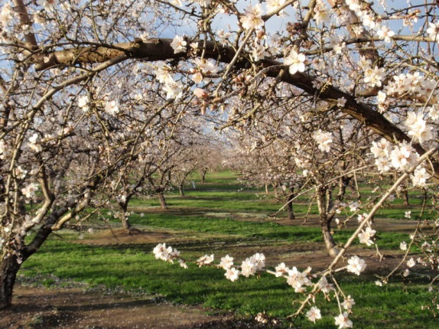
Success in Northern SJ Valley
San Joaquin COG staff recommended Scenario C, we advocated for D. Adopted plan a hybrid of C and D.
Stanislaus COG staff recommended Scenario B, we advocated for D. Board over-ruled staff and adopted a plan based on C.
San Joaquin County reduced road construction spending by 26%, increased active transportation spending by 78%, and transit by 28%.
Stanislaus County reduced the loss of farmland by over 30% compared to business as usual.
Both achieved dramatic (if questionable) GHG
reductions – greater than 20%.
Beginning a shift in culture and already working
on implementation.
Ripon almond blossoms (Ripon Chamber)
Notes:
Stanislaus and San Joaquin counties are both within the Diocese of Stockton. Stockton in SJ County, Modesto in Stanislaus County. Though I know more about SJ County and we did focus much more there.
SJ a high number of Bay Area and Sacramento commuters, but also rich agricultural heritage. Few large agri-business, trying to focus on the abundance of family-owned farms and a growing and thriving wine industry in Lodi (and I do NOT mean Gallo). However, also excited about things like Amazon distribution facilities in Stanislaus county that create thousands of jobs….in the middle of nowhere…and commuter-focused mixed-use developments like Mountain House (Tracy) and River Islands (Lathrop). These are basically mixed-use, commuter- (and somewhat transit-) oriented sprawl. Content to be Bay Area bedroom communities.
Our advocacy paid off!!
Good news by the numbers.
Beyond numbers, both counties had several good champions who really did take process seriously. These conversations are spilling over into other projects – Stockton just began the process to update its General Plan, in part to reflect the SCS, and Modesto will begin the same process shortly. Wood Colony residents in Stanislaus county are using the SCS as leverage to fight the development of their farmland, and the absorption of Salida as Modesto sprawls.
San Joaquin is finalizing an implementation Working Group that will include all of the cities in the County, the transit district, public health department, Sierra Club, and members of our Coalition. Will be approved at tomorrow’s Board meeting – not wasting any time!

Slide 6
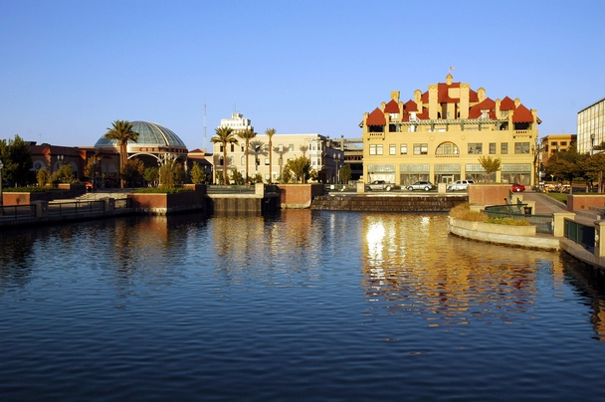
Success in Northern SJ Valley
Broad-based community coalitions – including builders & business!
Positive relationships with COG staff and Board members.
Downtown Stockton waterfront (Stockton City Limits)
Notes:
In both counties we had large, broad-based coalitions – including public agencies like the Health Department and local planning commissioners. Brought in the farming community, developers, local businesses, conservation, enviros, education, ethnic groups, faith groups – then disperse the right people to meet with the right Board members. It’s powerful to have an infill developer, and big name in Stockton, stand up next to the public health director and both support the SCS plan. Also had the local media on our side, overall the Stockton Record covered the issue well and was generally receptive to our statements. In Stanislaus we had Cal State students and family farmers allied to support the SCS. Liked the frame of choices – housing choices, transportation choices, etc.
Another key part of our success were friendly, frank, relationships with the staff. When the Coalition went out to celebrate our SJ success, the staff joined us, including the COG Director and member of the COG Board. And they are now calling on Coalition members to help with implementation, grant distribution, etc. They saw we were reasonable and cooperative, not adversarial, and I think we got a lot further.

Slide 7
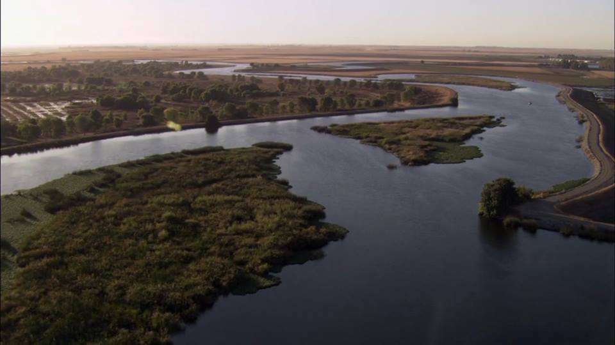
Challenges in Northern SJ Valley
Political will
Commuter culture
Modeling & inter-regional travel
Public participation
Sacramento-San Joaquin Delta (Restore the Delta)
Notes:
Despite more and more people moving from the Bay Area to San Joaquin County, it is still a pretty politically and culturally conservative place. The COG Board is entirely male, and with one exception, over 50 (I’m estimating). Spanos is very powerful, and they build large lot single family homes and office parks. The Climate Action Plan in Stockton has reigned them in somewhat, but they still bankroll the political campaigns. Cort is also very powerful, but we had them on our side.
Content to be bedroom communities – Lathrop, Tracy, Manteca, Ripon, Salida. Desire for large single family homes on cul de sacs still seem to rule the day in the eyes of the electeds, don’t see need for downtowns, walkability, bike lanes, etc. Do support ACE train.
As such, the question of inter-regional travel and how to measure it came up all the time. The number of trips each day from SJ to Bay Area are significant (though not actually as significant as the electeds would have you believe), and are ignored by the models.
The astounding GHG and VMT reductions also raise some eyebrows – though if the inter-regional trip issue is resolved these numbers will probably look a lot different.
Public participation needs to improve – workshops had good turnout in Stockton, Modesto, but not much input from beyond the cities (Wood Colony residents an exception). Implementation Working Group tasked with working on this. Getting residents to think beyond planned communities as the ideal for everyone – more choices for disadvantaged communities, older adults, youth, young adults

Slide 8
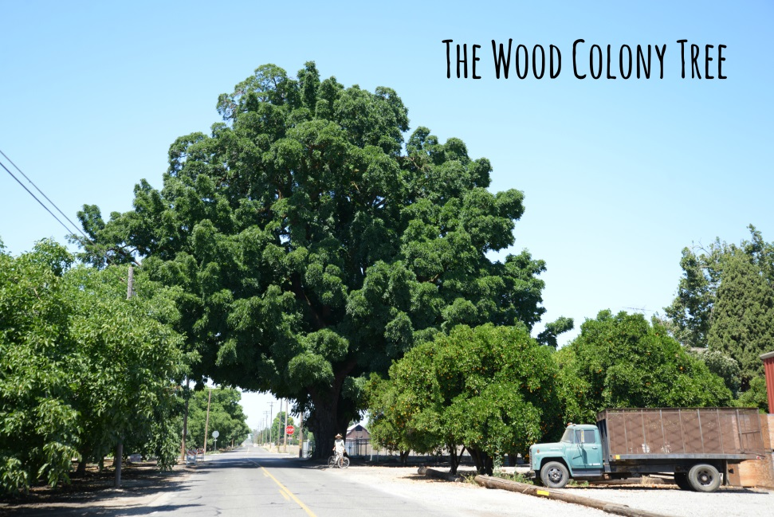
Going Forward…
Inter-regional trips
Improve modeling
Revisit targets
    Wood Colony tree, Stanislaus County (Save Wood Colony)
SJV COGS | 2020 Assigned | 2020 SCS Projection |  | 2035 Assigned | 2035 SCS Projection | SCS Exceeded Target?
San Joaquin | -5% | -24.4% |  | -10% | -23.7% | 2020, 2035
Stanislaus | -5% | -24-26% |  | -10% | -21-22% | 2020, 2035
Notes:
Top priority is the inter-regional trips – figuring how to include those in the models.
Improving modeling overall – explain where the dramatic reductions come from (and why they then increase) – WTH?
Revisit targets – given these issues, should these targets be raised?

Slide 9
Improved Transportation Spending
-26%
+15%
+28%
-36%
+132%
-32%
+25%
+78%

Slide 10
Fresno

Slide 11
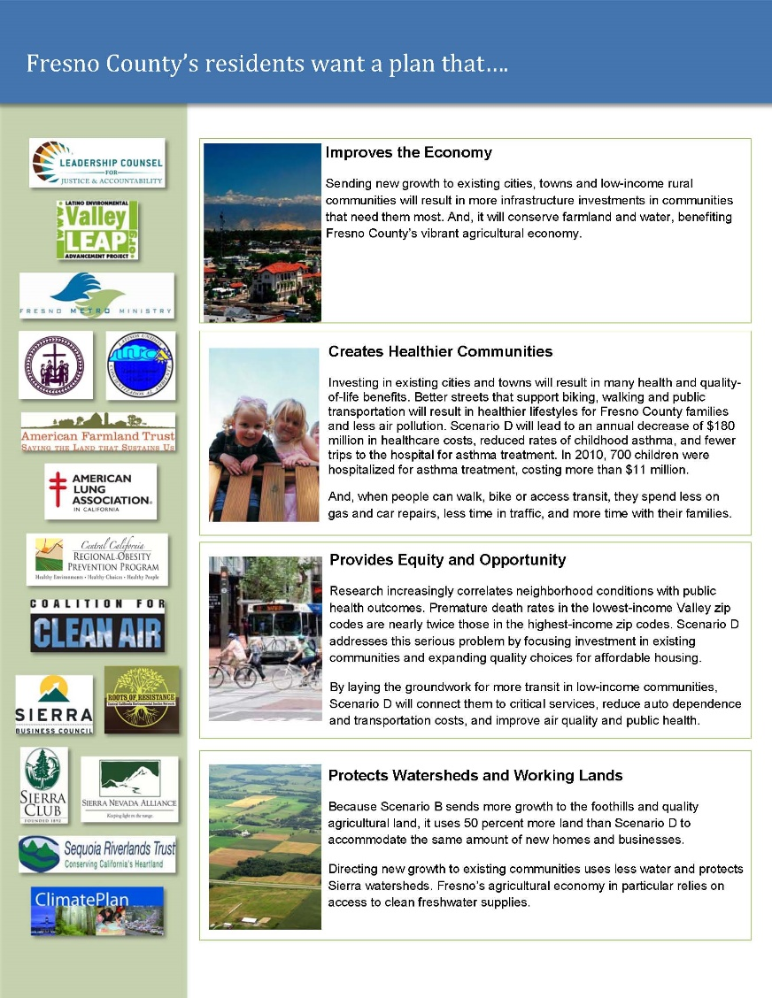
Success in Fresno
Unprecedented level of collaboration – Community Equity Coalition
Allies in key COG committees – formation of RTP Roundtable
Mini grants to CBOs to engage community
Use of multi prong strategies
Introduction of Scenario D

Slide 12
Scenario Comparison

Slide 13
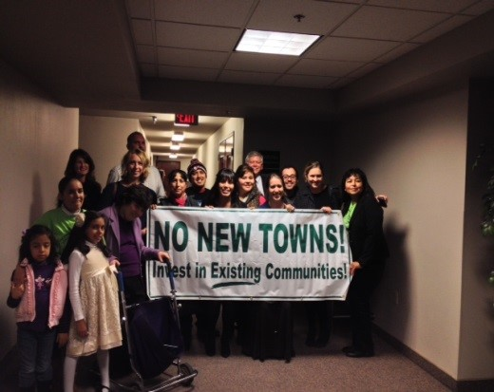
Success in Fresno
Increased spending on transit (+132%) and active transportation (+25%)
3 Policy Wins
  Grant Program
  Needs Assessment
  Farmland and open space preservation
Change in Dialogue
Health Metrics in Round 2

Slide 14
Challenges
Political will – leadership and education
Developer influence
Urban v Rural – housing and employment growth
Meaningful integration of public comment in process
Selection of projects before development of projected land use pattern
One transportation project list

Slide 15
Fresno: Moving Forward
CARB: Methodology Review and Target Update
3 groups set up at COG for policy wins
Engagement in local planning (2 key general plan updates)
Housing Element Updates
Implementation

Slide 16
Kern

Slide 17













Kern: Partners

Slide 18
Kern: Policy wins
  Infill/housing mix
  Transportation $ distribution
  Delayed & thinner highways
  Mitigation requirement
  Future improved jobs/housing balance & disadvantaged communities grant
Notes:
great changes in projected housing mix
small cities and disadvantaged unincorporated communities to engage in smart growth planning.
Kern’s plan contains seven times more funding both for bicycle/pedestrian infrastructure compared with their last long range transportation plan adopted in 2011.
- Conservation win--mitigation required for projects consistent with an SCS
Cog endorsed the idea of improving jobs/housing in four key low income communities and an allocation of $500,000 in the next fiscal year to support small cities and disadvantaged unincorporated communities to engage in smart growth planning

Slide 19
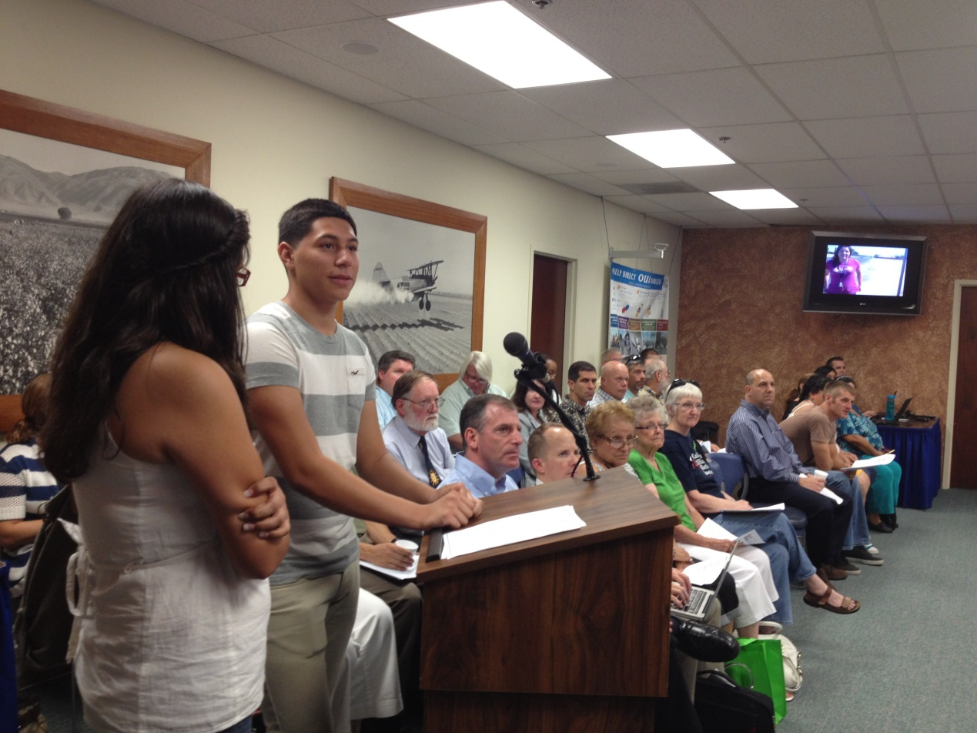
Kern: Process wins
  Local testimony at meetings
  Co-benefits
  Health metrics
Christopher Chavez and Maria Jose Diaz from
CA Walks and Greenfield Walking Group, 2013
Notes:
Powerful testimony at Regional Planning Advisory Council meetings and Kern COG meetings
The purpose of climate change does not resonate in Kern, but air pollution and household savings does. The use of co-benefits to demonstrate need for better planning was important here

Slide 20
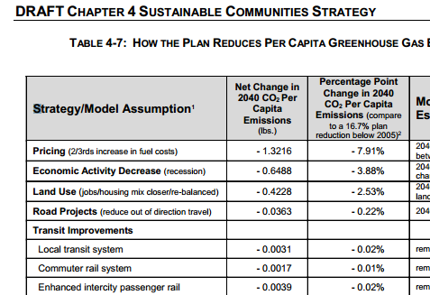
Kern: Challenges
  Reliance on assumptions
  Modeling methods
  Political unwillingness
  Jobs/housing
  balance
  Speculative active transpo $
  Stakeholder differences
Notes:
Policy:
- Most people are aware of this issue. Vast majority of GHG reduction from assumption about increased fuel cost and economic assumptions, not strategies
Leadership Counsel with technical support from the University of California, Center for Regional Change conducted a Health Impact Assessment (HIA) focused on SB 375 implementation in four target communities in Kern County – Arvin, Lamont, Weedpatch and Greenfield. This anticipates a worse jobs housing balance in those communities and likely communities beyond Bakersfield
- Much of the $ for active transportation comes from speculative sources
Process
- Great commonality but some differences in both policy and process. The focus of discussion on policy was whether to focus on metro Bakersfield or the county as a whole. The partners chose to write 2 final letters, one was the more “inside” approach and the other was a more “outside” approach.

Slide 21
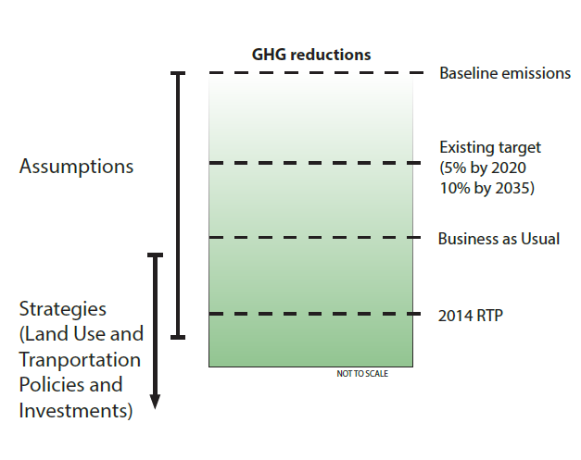
Kern: Moving forward
  Role of assumptions
  Modeling methods
  Transit-ready areas
  Infill infrastructure and finding resources
Notes:
Policy
This has implications on the integrity of SB 375 and the target-setting process currently underway. In addition, San Diego seems to have similar negligible mode shift yet large GHG reductions.
One of the issues in Kern that could inform other areas is how to expand benefits of SB 375 into rural areas. One idea that had traction was to identify “transit-ready areas.”
Process:
- Helping the region and local jurisdictions to implement. Utilizing cap and trade money, especially for disadvantaged comm and infill infrastructure in Bakersfield.

Slide 22
Questions? Comments?
Katelyn Roedner • Catholic Charities Stockton Diocese
Veronica Garibay • Leadership Counsel for Justice & Accountability
Ella Wise • Natural Resources Defense Council

